Slide 1
TCS Stock Prices Analysis
By Sahil

Slide 2
INTODUCTION
This report provides a detailed analysis of the stock performance and volatility trends of Tata Consultancy Services (TCS) over the period from 2002 to 2021.
Using Python for data cleaning, exploration, and visualization, the study captures trends in price movement, return patterns, volatility classification, and key market events affecting stock behavior.
Key findings reveal long-term upward momentum, distinct volatility patterns, and critical periods of continuous rise and decline.
The primary goal of this report is to analyze the historical stock price movements and volatility patterns of Tata Consultancy Services (TCS) from 2002 to 2021. As one of India's largest and most influential IT companies, TCS's stock behavior provides valuable insights into market sentiment, investor behavior, and external economic impacts over two decades.

Slide 3
DATASET OVERVIEW:
Column Name | Description
Date | The trading date for the stock entry.
Open | The price at which the stock started trading at the beginning of the day.
High | The highest price reached by the stock during that day.
Low | The lowest price reached during the trading day.
Close | The price of the stock at the end of the trading day. Often used for analysis.
Volume | The total number of shares traded on that day. Indicates market activity.
Dividends | The cash payments made by TCS to its shareholders on that date, if any.
Stock Splits | Indicates if a stock split occurred on that day. A split increases the number of shares while reducing the price proportionally.

Slide 4
📌 Data Preprocessing Steps
Step No. | Title | Description
1 | Importing Necessary Libraries | Imported essential libraries such as pandas, numpy, matplotlib.pyplot, and seaborn for data manipulation and visualization.
2 | Loading and Reading Data | Loaded the TCS stock data using pd.read_csv() or a similar function to read the dataset.
3 | Columns Overview | Displayed the list of all available columns to understand what information is present.
4 | Data Shape | Checked the number of rows and columns using .shape.
5 | Data Types | Used .dtypes to inspect the data types of each column.
— | Changing Data Type of Date Column | Converted the Date column from object type to datetime using pd.to_datetime().
6 | Checking Null Values | Verified missing values in each column using .isnull().sum().
6 | Drop Duplicates | Removed any duplicate rows using .drop_duplicates() to maintain data integrity.
7 | Statistical Summary | Used .describe() to get a quick summary of the distribution of numeric columns (mean, median, min, max, etc.).

Slide 5
EDA (Exploratory Data Analysis)
1.Extracting year , month and day from date for better visualization
And understanding
2."The years 2020, 2005, and 2010 recorded the highest number of trading entries in the dataset, each with approximately 250 data points, indicating complete and consistent data coverage for those years.“
3."Between 2002 and 2021, the month of July had the highest number of trading entries. It was followed closely by August with 394 entries and September with 390 entries."

Slide 6
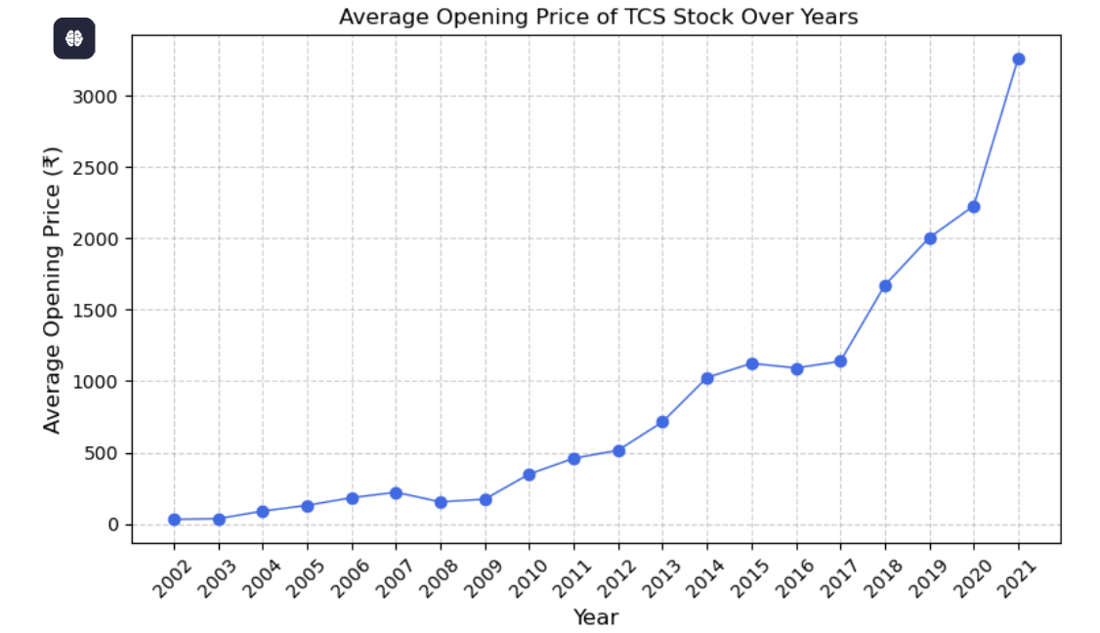
1. Average Opening Price of TCS Stock Over Years:
The TCS stock opening day price has shown significant long-term growth, especially after 2010, with a sharp increase in recent years.
The most notable jump occurred in 2021, reaching Rs 3261.23, indicating strong investor confidence and a booming tech sector.
There were brief periods of stability and dips, but overall, the trend remains upward.

Slide 7
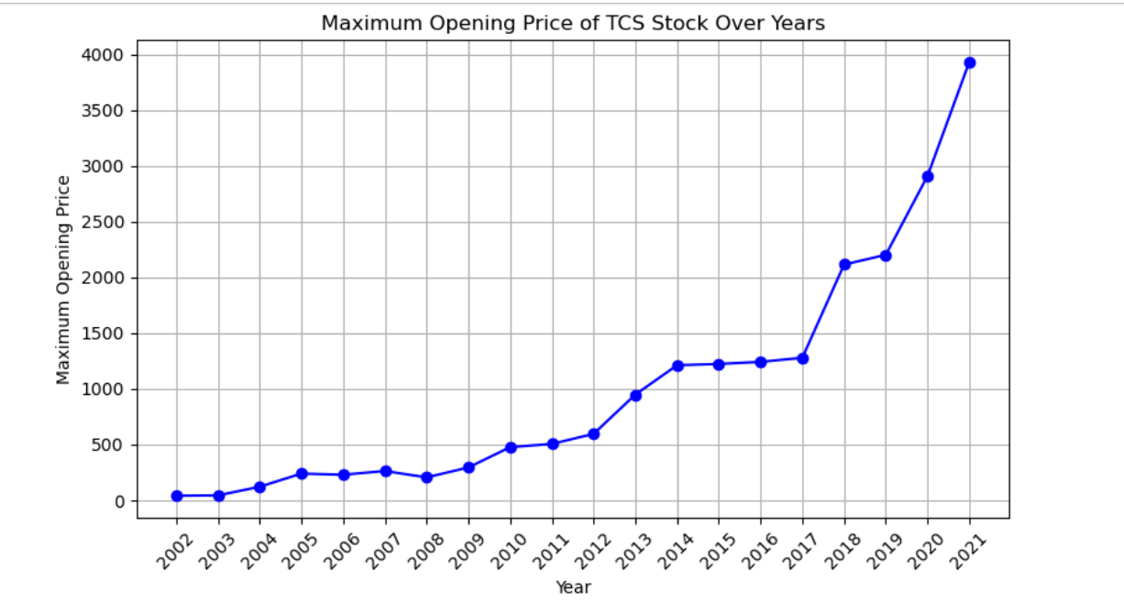
1.2.Maximum Opening Price of TCS Stock Over Years
The maximum opening price of TCS stock has generally increased over the years, with notable peaks in 2014, 2018, and especially in 2021, which reached the highest point ₹3930.
This indicates that the stock experienced its highest valuation moments in recent years, reflecting strong growth and market confidence.

Slide 8
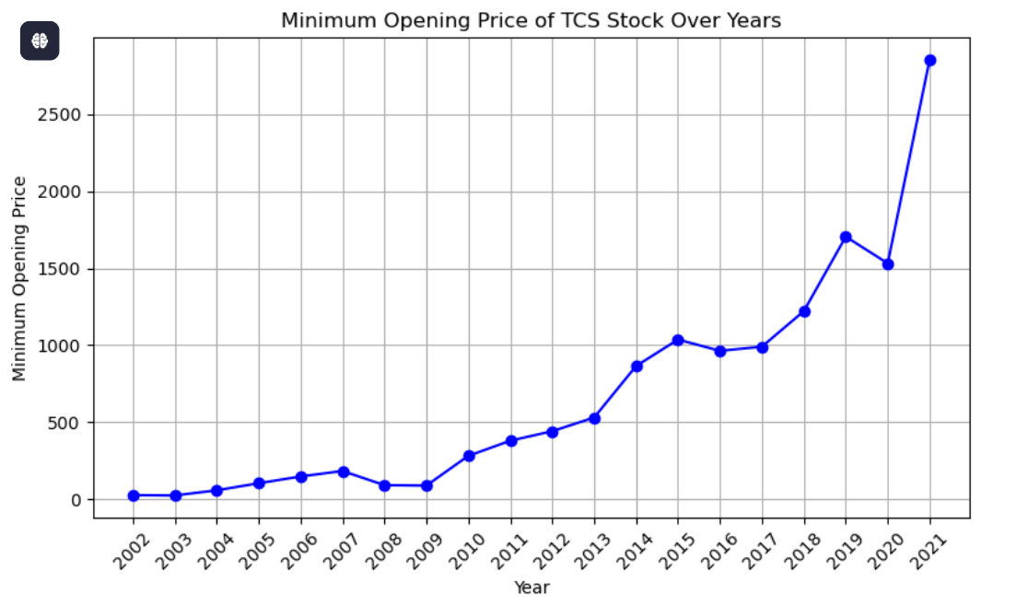
1.3.Minimum Opening Price of TCS Stock Over Years'
The chart indicates that the minimum opening price of TCS stock has generally increased over the years, with significant rises after 2010.
The sharpest increases occurred in 2014, 2018, and especially in 2021, reaching ₹2854.
This suggests a strong upward trend in the stock's lowest valuation points, reflecting overall growth and increased investor confidence in recent years.

Slide 9
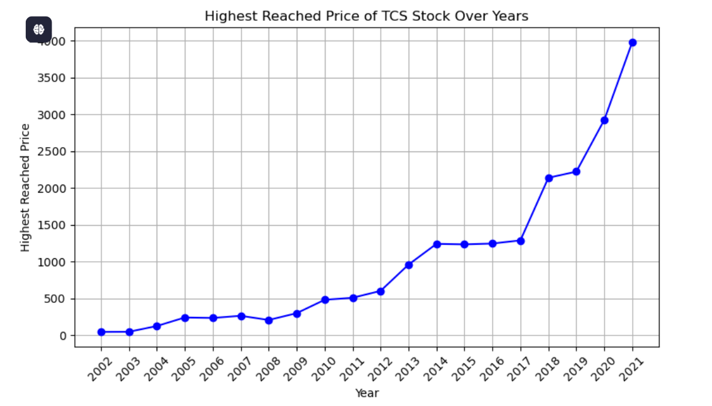
2.Highest Reached Price of TCS Stock Over Years
The chart shows that the highest reached price of TCS stock has mostly increased over the years, with a significant surge after 2010.
The peak in 2021, around ₹4000, highlights the stock’s strong upward momentum, indicating increased investor confidence and substantial growth in its valuation over time

Slide 10
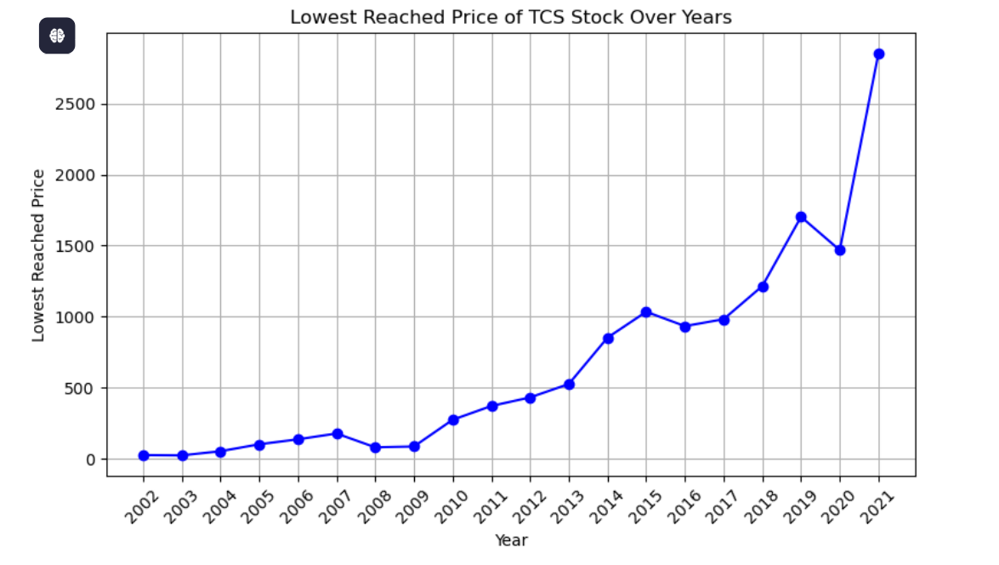
3.Lowest Reached Price of TCS Stock Over Years
The chart indicates that the lowest reached price of TCS stock has consistently increased over the years, especially after 2010.
The most notable rise occurred in 2021, reaching ₹2853, reflecting strong growth and rising investor confidence in recent years.

Slide 11
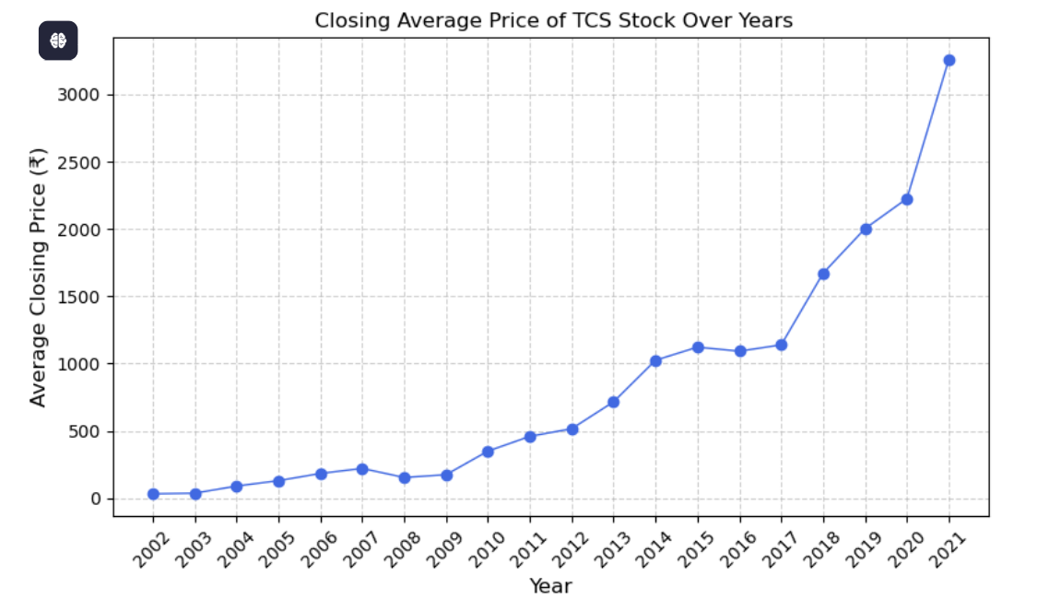
4.Closing Average Price of TCS Stock Over Years
The chart shows that the closing average price of TCS stock has generally increased over the years, with a marked acceleration after 2010.
The most recent peak in 2021, reaching around ₹3954, highlights strong growth and investor confidence in recent years.

Slide 12
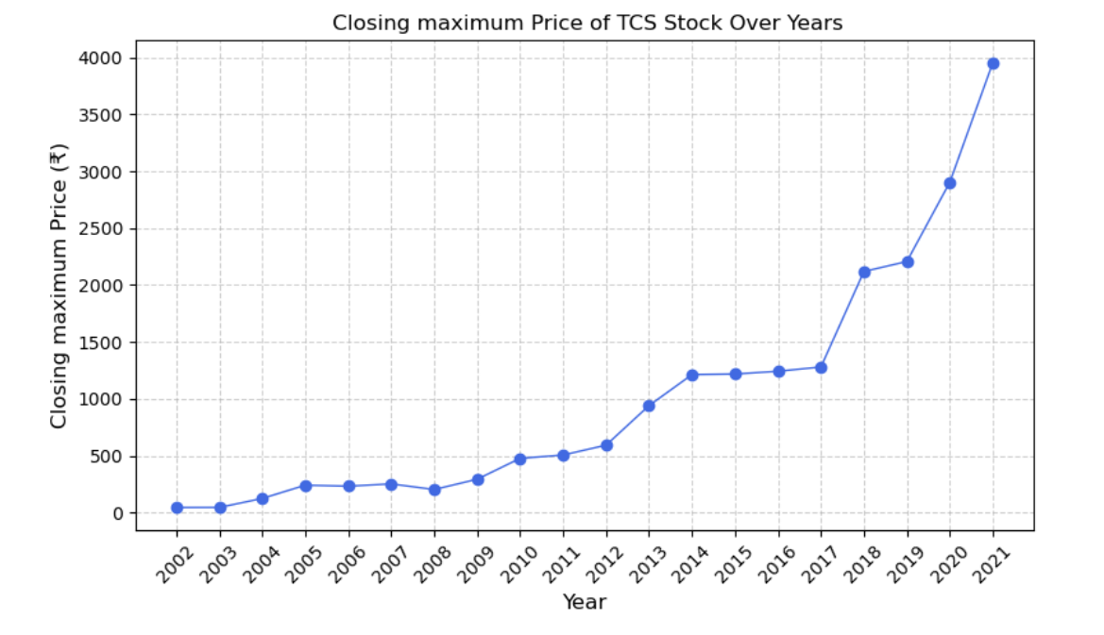
4.2.Closing maximum Price of TCS Stock Over Years
The chart shows that TCS stock's closing maximum price has generally increased over the years, with notable acceleration after 2010.
The peak in 2021, reaching nearly ₹4000, highlights strong growth and investor confidence in recent years, with the highest valuation points occurring in 2021.

Slide 13
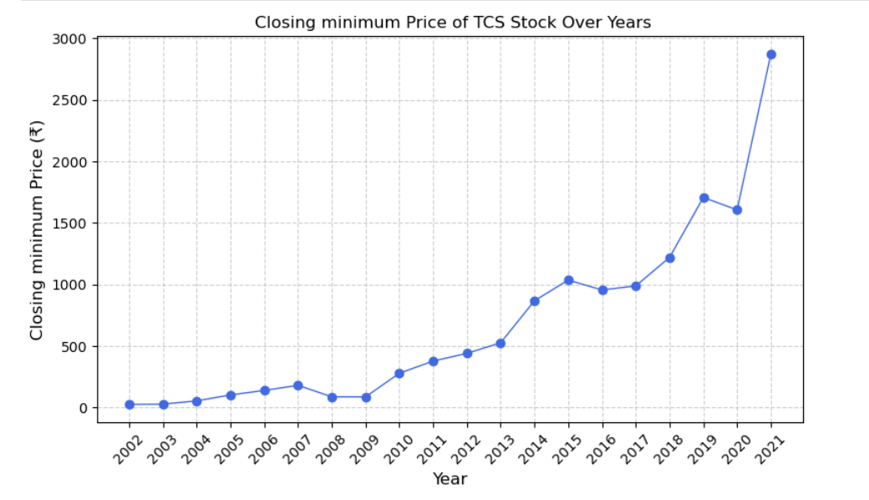
4.3Minimum Closing price of TCS Stocks over years:
The minimum closing price of TCS stock showed stable behavior in the early 2000s, dipped during the 2008 financial crisis, and then steadily increased from 2010 onwards.
Notably, post-2018 saw sharp growth, peaking in 2021 near ₹2900. This overall upward trend reflects long-term growth and increasing stability in TCS’s stock performance.

Slide 14
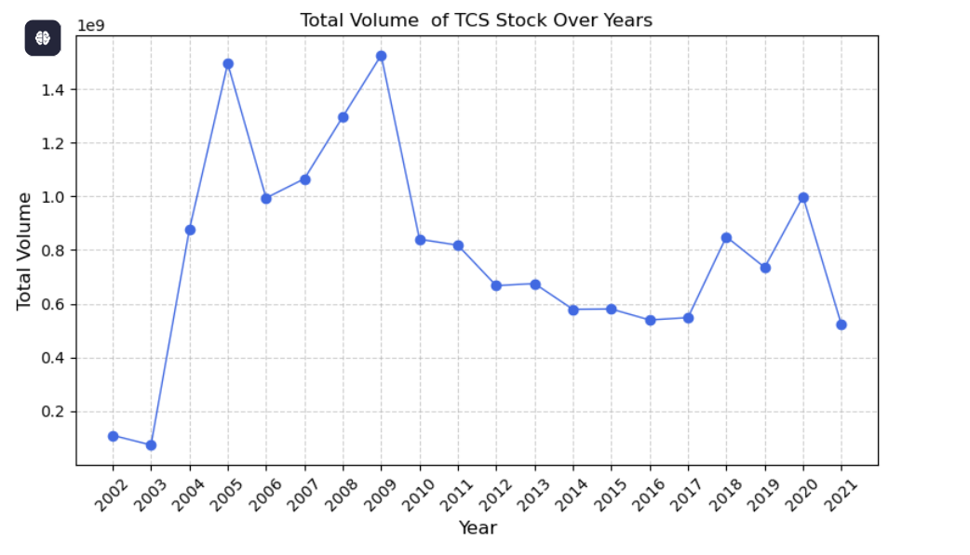
5. .Distribution of Volume of TCS Stocks over Years:
The line chart shows TCS trading volume from 2002 to 2021.
Volume peaked around 2005–2008 (~1.5 billion units), then declined with fluctuations.
Moderate spikes appeared in 2017 and 2019. Trading volume in 2020–2021 remained lower than peak years but still higher than the early 2000s.

Slide 15
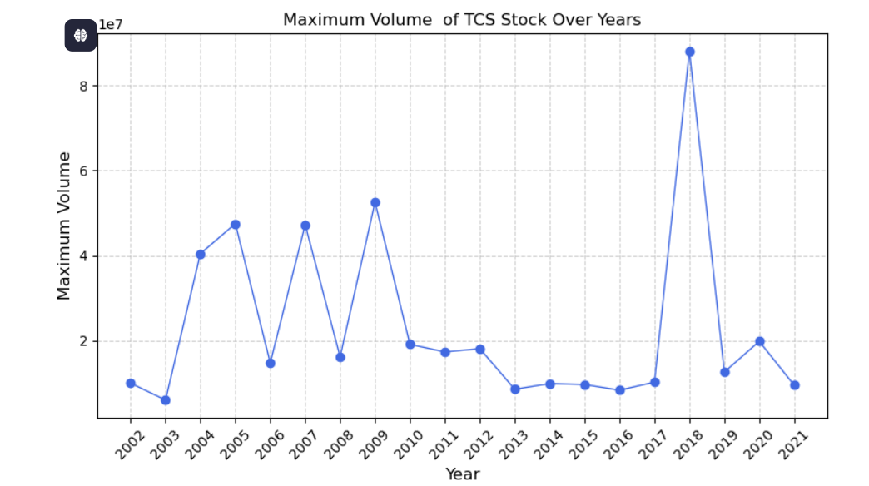
5.2 Maximum Volume traded per year
The chart shows TCS's maximum trading volume from 2002 to 2021.
Major peaks appear between 2005–2009, with a sharp spike in 2018 (~90 million). Post-2018, volumes drop but stay higher than earlier years.
Years like 2003, 2006, and 2010 show lower peaks, reflecting quieter trading periods.

Slide 16
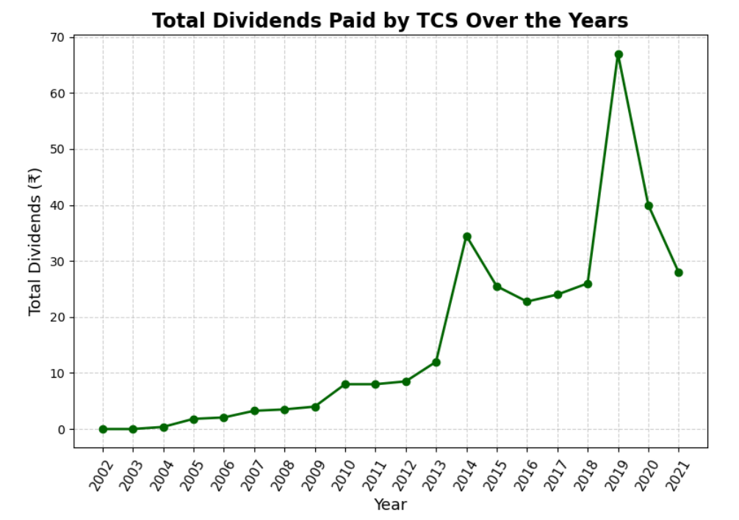
6.Dividend Distribution in TCS STOCK
2002–2012: Gradual and steady increase in dividends — reflects stable growth.
2013–2014: Sharp surge in payouts — likely due to high profits or strategic decision.
2018–2019: Major peak in 2019 — highest dividend, possibly a special payout.
2020–2021: Decline after the peak — but still higher than earlier years.
Overall Insight: Consistent dividend growth with occasional sharp increases indicating profitability and strategic distribution.

Slide 17
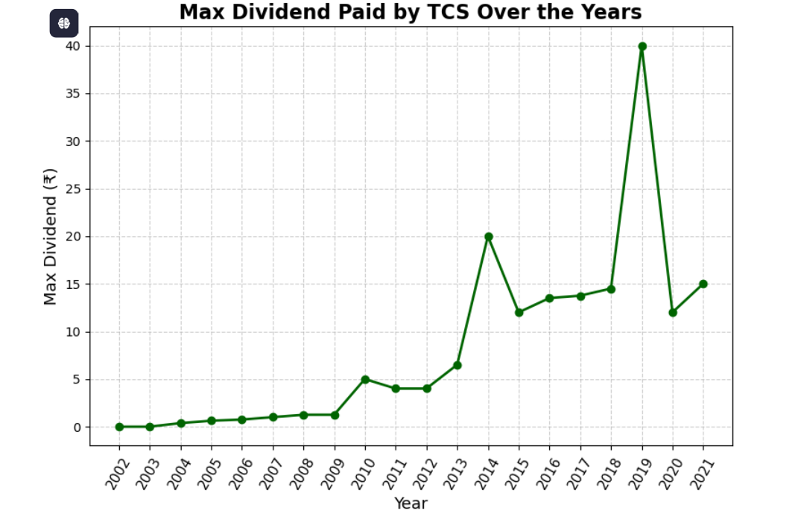
6.1 Maximum Dividends Paid by the TCS Stock Over Years
Overall Growth: Gradual increase in maximum dividends over time — shows rising profitability and confidence.
Major Peaks: Highest dividend in 2019, indicating exceptional performance or strategic payout.
Notable Spikes: Significant jumps in 2013 (₹20) and 2019 (₹40) — standout years.
Yearly Variations: Moderate increases (e.g., 2016–2018) vs. sharp rises (e.g., 2013, 2019).
Recent Years: Sharp drop in 2020, slight recovery in 2021 — reflects fluctuating profits or strategy shifts.

Slide 18
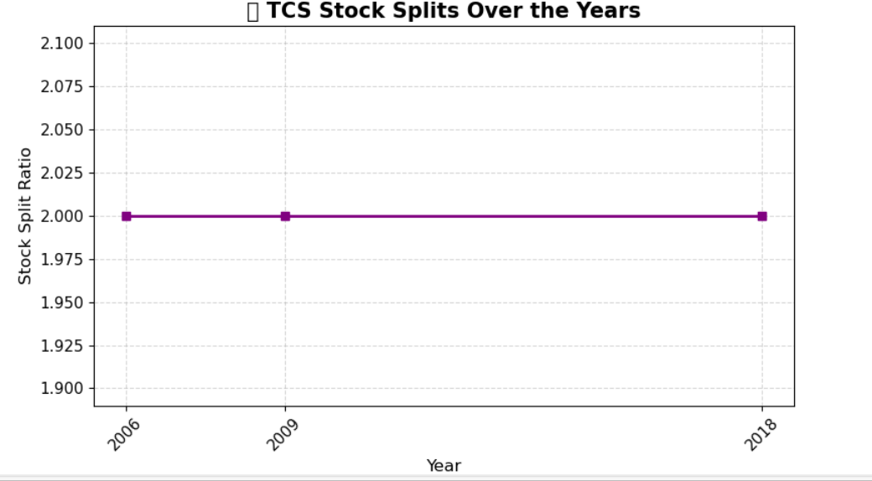
7.Distribution of TCS Stock Split over years
The line graph shows that the TCS stock split ratio remained constant at 2.00 from 2006 to 2018. This indicates that TCS has not changed its stock split ratio during these years, reflecting a stable approach to stock split policy over this period.

Slide 19
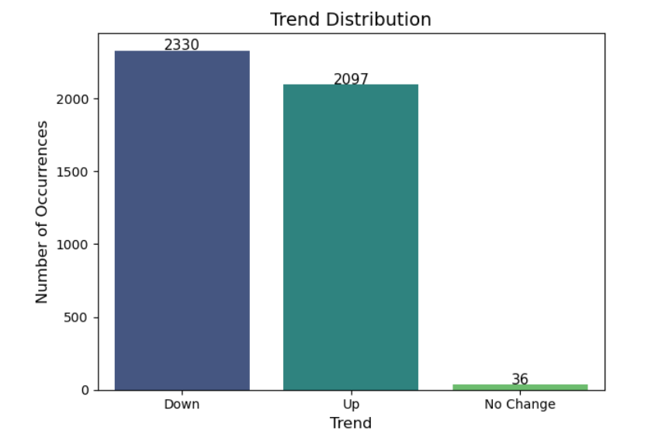
8. Stock Prices Trend Distribution.
Trend Distribution Summary
Most Frequent: "Down" trend dominates with 2,330 occurrences — indicates frequent declines.
Second Highest: "Up" trend appears 2,097 times — shows many upward movements.
Least Common: "No Change" has only 36 instances — stability is rare.

Slide 20
9.Insight:
9.2 For How many days Opening Prices and High Prices were same throughout the day:
9.1For how many days Closing price and Low price of Stock Were Same:
There are 25 days when closing and low price were same.
# INSIGHT
The stock closed at its lowest price of the day.
This implies that:
The stock price declined throughout the day, and It never recovered before the market closed.
There are 434 days when opening
Prices and High Prices were same
# INSIGHT:
This is a bearish sign because the price never exceeded the opening price during the entire day.
this pattern could be a signal of short-term reversals or selling pressure.

Slide 21
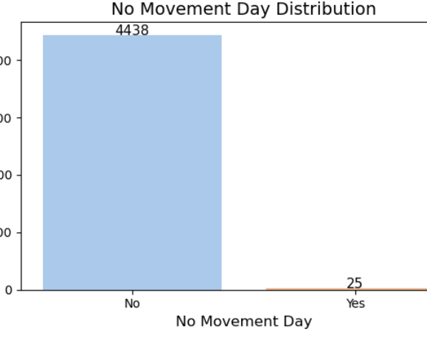
10.No Movement day:
IF ON A DAY OPEN PRICE = HIGH PRICE = lOW PRICE = CLOSE PRICE
THAT DAY IS CALLED NO Movement day’:
# INSIGHT--There are 25 days when the stock price remained constant throughout the day
Holiday or Half-Day Market (Technical Day) The market might have had a shortened session, or trading was halted.

Slide 22
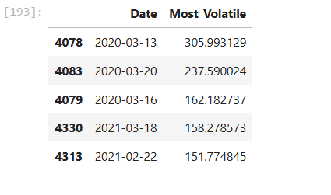
11.Top 5 Dates when Stock Was Most Volatile
Price range =(High - Low ) how much the price fluctuated from its lowest point to its highest point that day.
# Insight-
Most volatile stock price was 305.9993129 on 2020-03-13:“TCS experienced its most volatile trading day on March 13, 2020, with an intraday price swing of ₹305.99, reflecting the broader market crash driven by pandemic fears corona.
This volatility highlights how even fundamentally strong stocks are not immune to global events.”

Slide 23
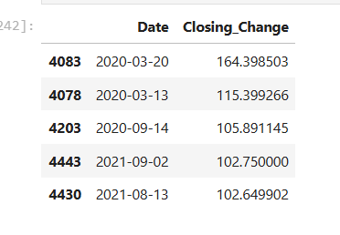
12. Close Change
Close Change = How much stock gained or loss in a single day
Close change = close – open
# Insight:
On March 20, 2020, TCS saw its largest single-day closing price gain of ₹164.40, likely driven by investor optimism after a period of heightened COVID-19-driven volatility.
This spike reflects TCS’s resilience and investor confidence in the IT sector during uncertain times."

Slide 24
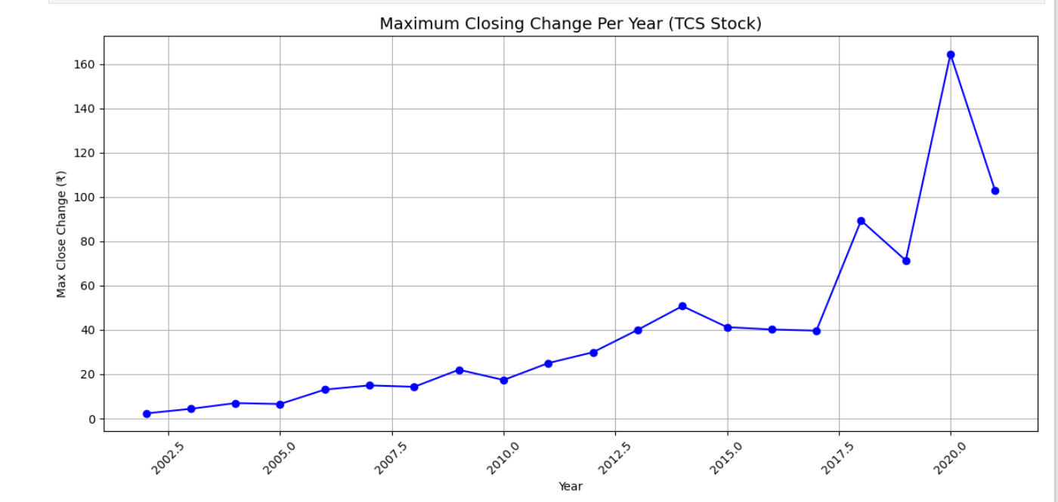
12.1 Highest Close Change Per Year:
Insight:
2002–2019: Gradual upward trend in daily price change — indicates rising volatility over the years.
2020 Spike: Sharp increase in 2020 (₹160+) — likely due to COVID-19 market volatility.
Post-2020: Slight decrease after 2020, but still higher than earlier years — shows continued high volatility.

Slide 25
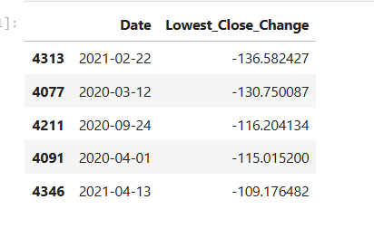
12.2 TOP 5 DATES WHEN CLOSE CHANGE WAS LOWEST
# Insight:
On 22nd February 2021, the TCS stock price fell by ₹136 in one day. This was a big drop. –
Reasons:
People were selling to take profits– The stock may have gone up earlier, so many investors sold it to lock in their profits. This caused the price to fall.
Overall market was down– Sometimes when the whole stock market is falling (due to news or economic issues), big stocks like TCS also go down.
IT sector was weak– Other technology companies might also have been falling that day, which can affect TCS too.

Slide 26
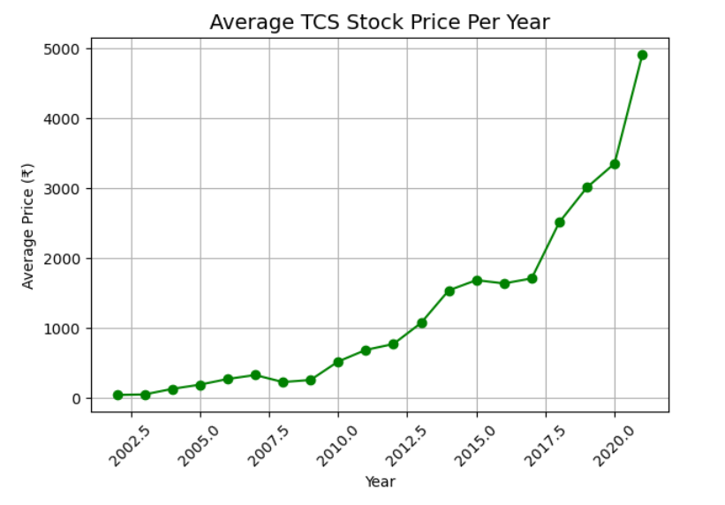
13. Average price of Stocks:
2002–2010: Stable prices with gradual growth.
Post-2010: Accelerated growth in stock price begins.
Post-2017: Sharp rise in value — strong upward momentum.
By 2020: Stock price nears ₹5000 — reflects strong performance and investor confidence.

Slide 27
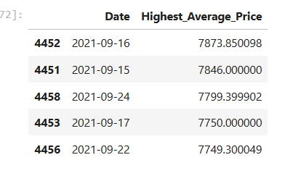
13.1 Top 5 DAY with highest average price of stocks
#Insight:
TCS’s stock price went very high on that 2021-09-16 —
It had the highest average price ever.
The reason was that TCS became the first Indian IT company to reach a $200 billion value in the stock market.
This made a lot of investors excited, and they bought more shares, pushing the price even higher.

Slide 28
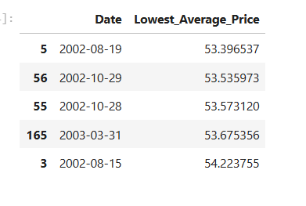
13.2 Top 5 DAYS With Lowest Average Stock Prices
# Insight
TCS had its lowest average stock price on August 19, 2002, at around ₹53.39.
This was because it was early in the company’s journey, before it officially went public, and its value had not yet grown.

Slide 29
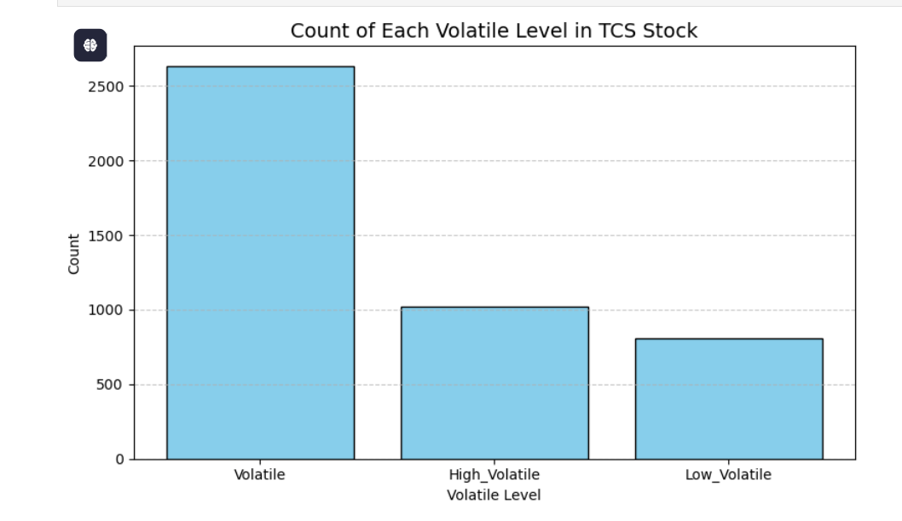
14. Intraday Volatility
1.Intraday volatility refers to the price fluctuations of a stock within a single trading day.
A stock is said be highly volatile if intradity volatility is between 3 to 5 percent:
intraday_volatility_% = ((high-low)/open)) * 100
if'Intraday_Volatility_% <= 1.5 then "Low_Volatile“
if 'Intraday_Volatility_% >1.5 and <=3.5 then "Volatile
else "High Volatile“
Moderate Volatility: Most frequent — 2,636 days; indicates steady trading.
High Volatility: Significant — 1,018 days; likely due to news or earnings.
Low Volatility: Least common — calm days were rare.

Slide 30
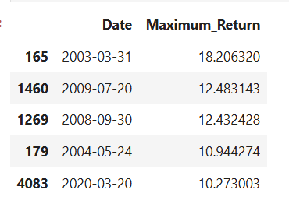
15.Return Percentage
Return Percentage tells you how much profit or loss you made (or could have made) on a stock over a period of time — expressed as a percentage of your original investment.
Highest return was on 2003-03-31 at 18.21%, likely due to strong market recovery.
2009-07-20 (12.48%) and 2008-09-30 (12.43%) reflect post-crisis market volatility during the 2008 financial crisis.
2020-03-20 (10.27%) return came during the COVID-19 crash rebound.
These spikes highlight how markets respond sharply during major economic events.

Slide 31
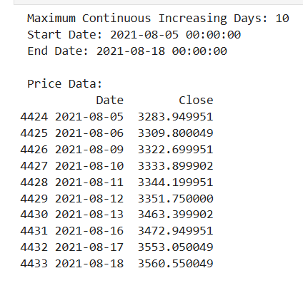
16 Dates with continuous Increasing stock prices streaks.
Insight:
There are 2842 days from 2002-01-01 to 2021-12-31 when market was closed
The 10-day continuous price rise in August 2021 was primarily due to strong Q1 earnings, global and domestic tech sector optimism,
and renewed investor confidence post-COVID disruptions

Slide 32
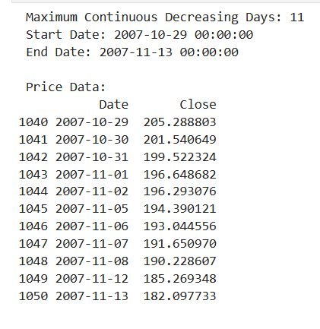
17.Dates with the longest Continuous Decrease stock Prices streak:
Insight:
The 11-day price fall in TCS stock (Oct 29–Nov 13, 2007) was driven by global market fears due to the subprime mortgage crisis, rupee appreciation hurting IT exporters, and widespread investor risk aversion.

Slide 33
Conclusion: The analysis of Tata Consultancy Services (TCS) stock performance from 2002 to 2021 reveals a pattern of sustained long-term growth, strong market confidence, and high resilience despite periodic volatility.
Consistent Upward Growth: TCS’s stock price has shown a steady increase over two decades, with a marked acceleration after 2010. The upward trend in opening, closing, and highest prices indicates sustained investor confidence and strong financial performance.
2021 Peak Performance: The stock reached its all-time high in 2021, driven by robust global demand for digital transformation, strong quarterly earnings, and renewed investor optimism post-pandemic.
Volatility Trends: TCS experienced periodic high volatility during major global events — the 2008 financial crisis and the 2020 COVID-19 market crash — but consistently rebounded quickly, reflecting market trust and strong fundamentals.

Slide 34
Conclusion
Trading Volume Shifts: Trading activity peaked between 2005–2008 and again in 2018–2019, showing that investor interest increases during major market movements and earnings cycles.
Dividend Growth: Dividend payouts steadily increased from 2002 to 2019, peaking in 2019 with special payouts. This consistent distribution highlights profitability and shareholder-friendly policies.
Market Resilience: Despite fluctuations, TCS has maintained long-term stability, low debt, and steady profitability, reinforcing its image as a defensive and high-quality stock in India’s IT sector.
Leadership and Sector Strength: TCS’s performance mirrors the growth of the Indian IT industry, maintaining leadership through global expansion, strong client retention, and operational excellence.

Slide 35
Recommendations
1. Investment Perspective
TCS remains a strong long-term investment option for investors seeking stable returns and lower risk.
Encourage systematic investment strategies (SIP) in TCS to average out short-term market fluctuations.
2. Risk and Volatility Management
Monitor intraday volatility (3–5%) closely during market downturns, as it often signals broader market sentiment shifts.
Short-term investors should apply stop-loss mechanisms during global uncertainty periods like 2008 and 2020.
3. Dividend Strategy Optimization
Maintain or slightly increase dividend payouts in profitable years to sustain investor confidence.
Introduce interim dividends or share buybacks to reward long-term shareholders.
4. Investor Communication
Continue transparent reporting of quarterly earnings and sustainability initiatives to reinforce investor trust.
Highlight achievements in global digital transformation projects, AI, and automation — key drivers for future valuation growth.

Slide 36
Recommendations
5. Sector and Market Positioning
Leverage the growing demand for IT services in cloud computing, AI, and cybersecurity to sustain growth momentum.
Continue diversification across international markets to hedge against domestic economic fluctuations.
6. Future Forecasting and Monitoring
Regularly track year-over-year revenue growth and EPS trends to assess fundamental strength.
Use predictive analytics models to forecast stock price movement based on macroeconomic indicators and tech sector performance.
7. Strategic Insight for Stakeholders
Portfolio managers and retail investors should treat TCS as a core holding for stable, long-term capital appreciation.
Short-term traders can capitalize on volatility during earnings seasons or sector-wide rallies.

Slide 37
Summary Insight:
TCS’s long-term performance underscores its financial strength, operational excellence, and market leadership. Despite short-term volatility, it continues to deliver consistent shareholder value. As the IT industry accelerates toward digital transformation, TCS stands well-positioned for sustainable growth in the coming decade.

